Slide 1

FORGERY IMAGE DETECTION SYSTEM TEAM MEMBERS ABRAHAM JUSTIN 23MIA1027 VENKATARAMAN R 23MIA1025 SUDARSHAN MANIKANDAN 23MIA1078

Slide 2
PROBLEM STATEMENT
To develop a hybrid forgery detection system capable of:
Classifying images as Authentic or Tampered
Identifying and localizing forged regions
Detecting copy-move operations even in smooth and low-texture areas
Achieving high accuracy while providing explainability

Slide 3
MOTIVATION STATEMENT
Digital images are widely used in media, journalism, legal evidence, and social networks.
Image manipulation tools make tampering easier, more realistic, and harder to detect.
Copy-Move forgery is challenging as the copied region shares the same texture & lighting as the original.
Deep learning improves classification accuracy but lacks interpretability without localization.

Slide 4
BASE PAPER SUMMARY
Base Paper : “An Effective Image Copy-Move Forgery Detection Using Entropy Information” (IEEE, 2024)
Traditional SIFT-based Copy-Move Detection struggles in smooth regions due to fewer keypoints.
The paper introduces entropy images to generate more stable keypoints.
Keypoint orientation is redefined using gray image for improved feature accuracy.
An overlapped entropy-level clustering algorithm is proposed to improve matching efficiency.
Achieves high detection accuracy (TPR 99.07%, FPR 0%).This inspired the SIFT enhancement & matching stage in our hybrid model.

Slide 5

METHODOLOGY FLOW DIAGRAM

Slide 6
RESULTS – MODEL OUTPUTS

Slide 7
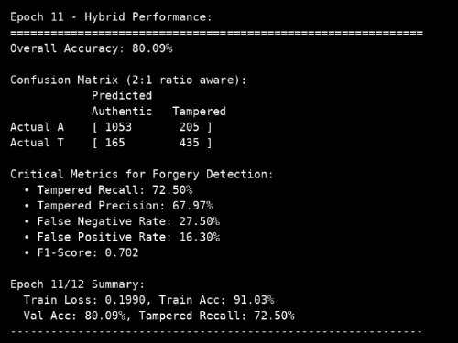
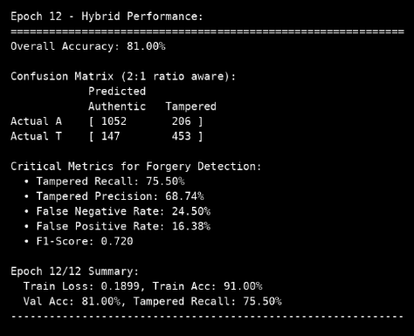
RESULTS - CLASSIFICATION METRICS

Slide 8
KEY FINDINGS
Hybrid approach significantly improves detection compared to single-method models.
Grad-CAM enhances interpretability and shows where manipulation occurs.
Entropy-based SIFT improves keypoint density in smooth areas.
Copy-Move detector effectively highlights duplicated regions.
Performs well across various image resolutions and tampering types.

Slide 9
FUTURE ENHANCEMENTS
Integrate Vision Transformers (ViT, Swin-T) for better contextual understanding.
Add JPEG artifact analysis for improved splicing detection.
Build a real-time system for image/video forensics.
Use Approximate Nearest Neighbor (ANN) for faster keypoint matching.
Expand dataset to include deepfake and GAN-based manipulations.

Slide 10

Thank you

